Slide 1


Object Tracking (with Yolo and DeepSORT)
Amirata Ghaffarian
Shervin Ghaffari

Slide 2


CONTENTS
1、Introduction
2、YOLO
3、DeepSORT

Slide 3
1、Introduction

Slide 4
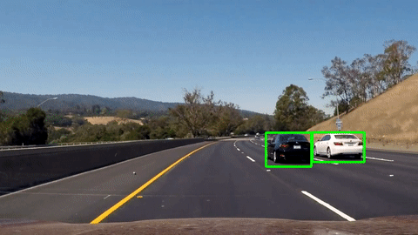
Object Tracking
Object tracking is the task of taking an initial set of object detections, creating a unique ID for each of the initial detections, and then tracking each of the objects as they move around frames in a video, maintaining the ID assignment.

Slide 5
Challenges
Here are some challenges in object tracking:
Occlusion: It occurs when an object we are tracking is hidden (occluded) by another object. Like two persons walking past each other, or a car that drives under a bridge. The problem in this case is what you do when an object disappears and reappears again.
Scale change
Background clutter: Background near object has similar color or texture as the object. Hence, it become harder to track results for a small object with cluttered background.
Appearance change: Different viewpoint of an object may look very different visually and without the context. Hence, it become very difficult to identify the object using only visual detection.

Slide 6
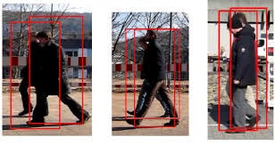
Occlusion problem on pedestrian tracking

Slide 7
Traditional methods
Optical Flow
Optical flow calculates motion by analyzing changes in image brightness across frames. It’s effective but sensitive to noise and illumination changes, requiring high computational power.
Meanshift
Mean Shift is an iterative algorithm that tracks objects based on color features. It’s simple and fast but can struggle in complex visual environments.
Kalman Filters
Kalman Filters predict an object’s position and velocity by averaging past data with new measurements, effectively handling small occlusions and movement complexities. It assumes noise is Gaussian, limiting its use in non-linear situations.

Slide 8
2、YOLO

Slide 9
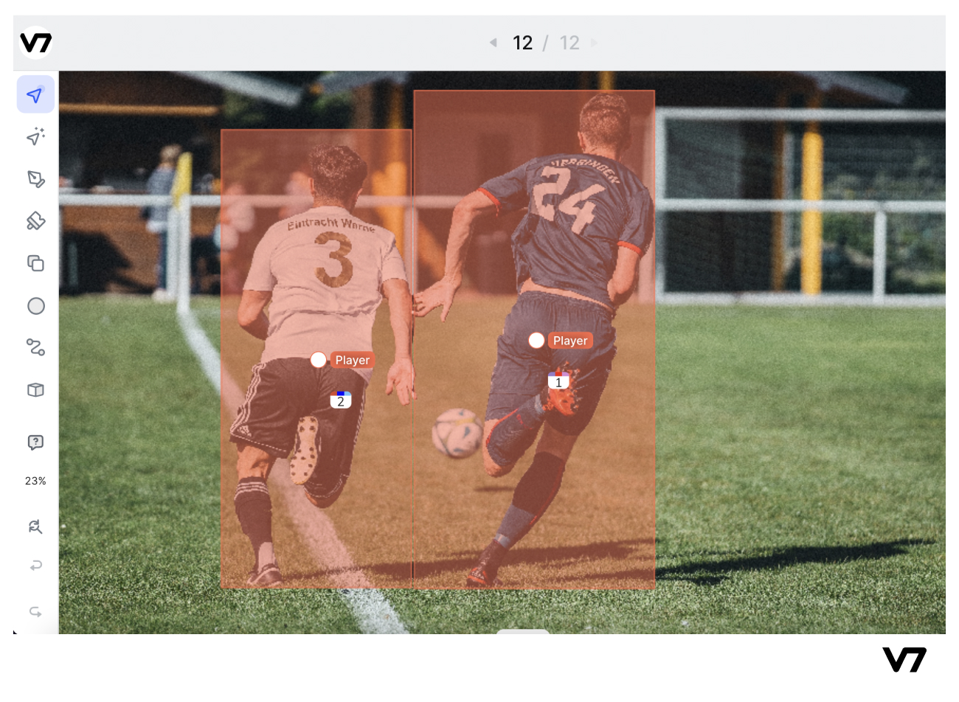
What is object detection?
Object detection is a computer vision task that involves identifying and locating objects in images or videos. It is an important part of many applications, such as surveillance, self-driving cars, or robotics. Object detection algorithms can be divided into two main categories: single-shot detectors and two-stage detectors.

Slide 10
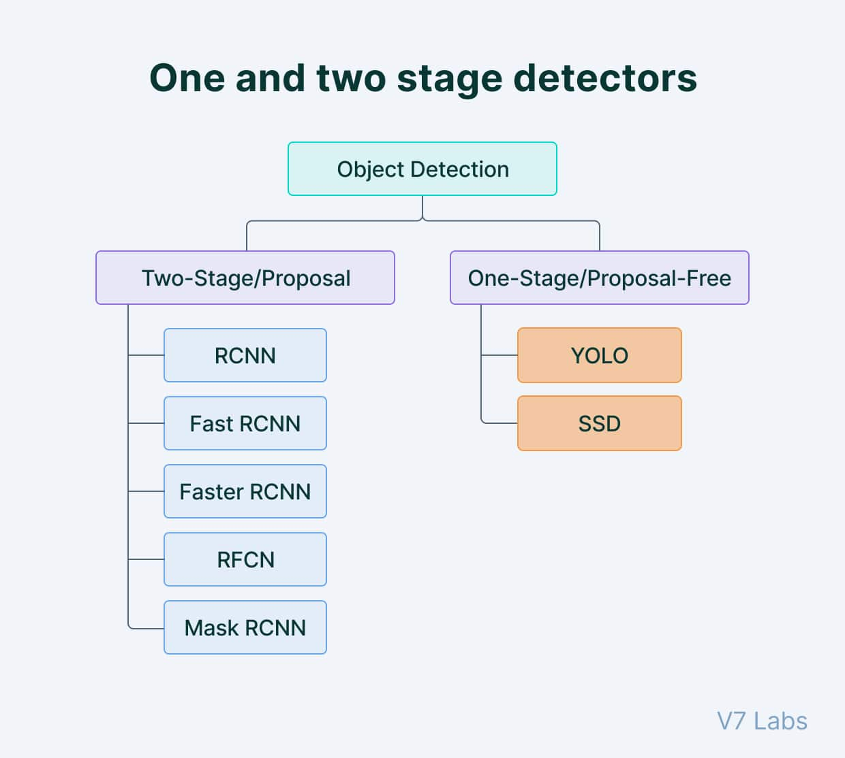
Object detection algorithms are broadly classified into two categories based on how many times the same input image is passed through a network.

Slide 11
Single-shot Object Detection:
Single-shot object detection processes an entire image in one pass, making it computationally efficient but generally less accurate, particularly for detecting small objects; exemplified by YOLO, a fully convolutional neural network (CNN) model.
Two-shot Object Detection:
Two-shot object detection involves two passes of the input image, with the first pass generating proposals and the second pass refining predictions; offering increased accuracy at the cost of higher computational complexity, making it suitable for applications prioritizing accuracy over real-time performance.

Slide 12
Object detection models performance evaluation metrics
Intersection over Union (IoU):
IoU is a metric that measures the overlap between predicted and ground truth bounding boxes in object detection, calculated as the ratio of the intersection to the union of the two bounding boxes, providing an indication of localization accuracy.
Average Precision (AP):
AP is calculated as the area under the precision-recall curve, quantifying the trade-off between precision and recall for a set of predictions in object detection; mean Average Precision (mAP) is the average AP value taken over all classes, indicating overall model performance.

Slide 13
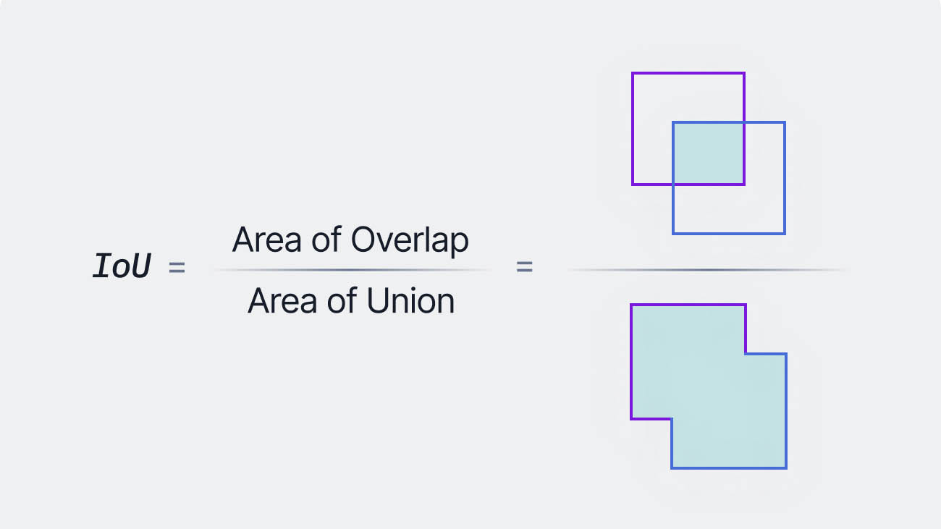

Slide 14
YOLO: Algorithm for Object Detection
YOLO (You Only Look Once) is a popular object detection model known for its speed and accuracy. It was first introduced by Joseph Redmon et al.
YOLO employs a single neural network to predict bounding boxes and class probabilities simultaneously, distinguishing itself from traditional methods by achieving real-time performance and state-of-the-art results.

Slide 15
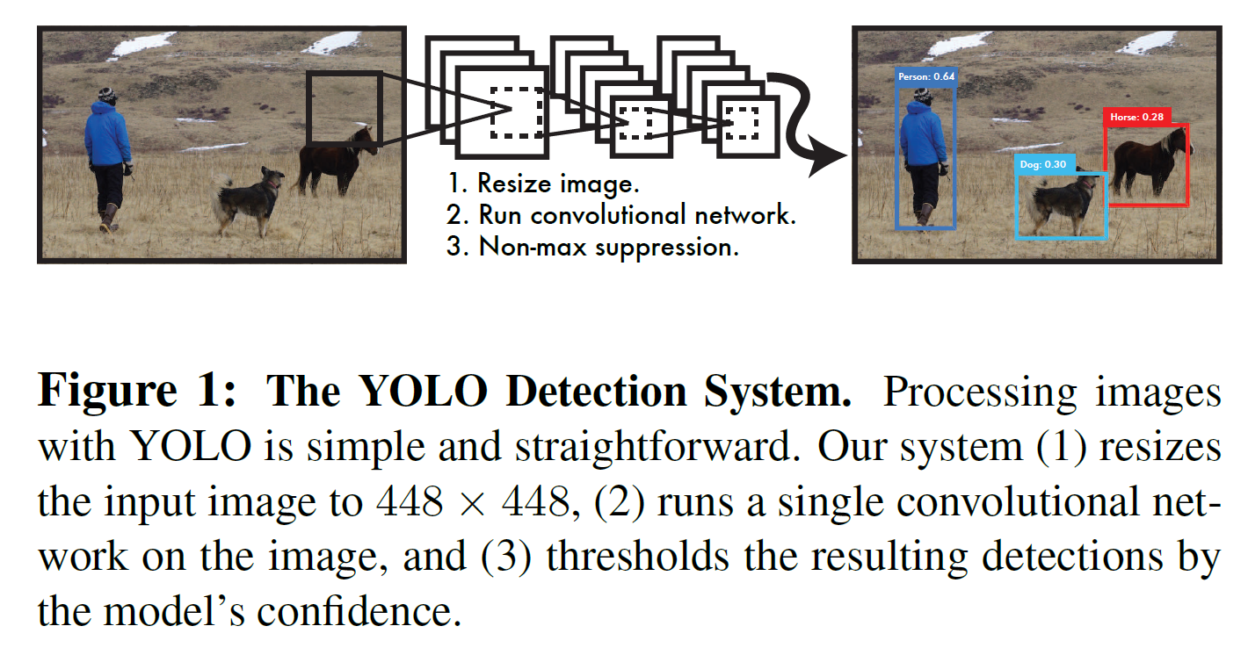

Slide 16
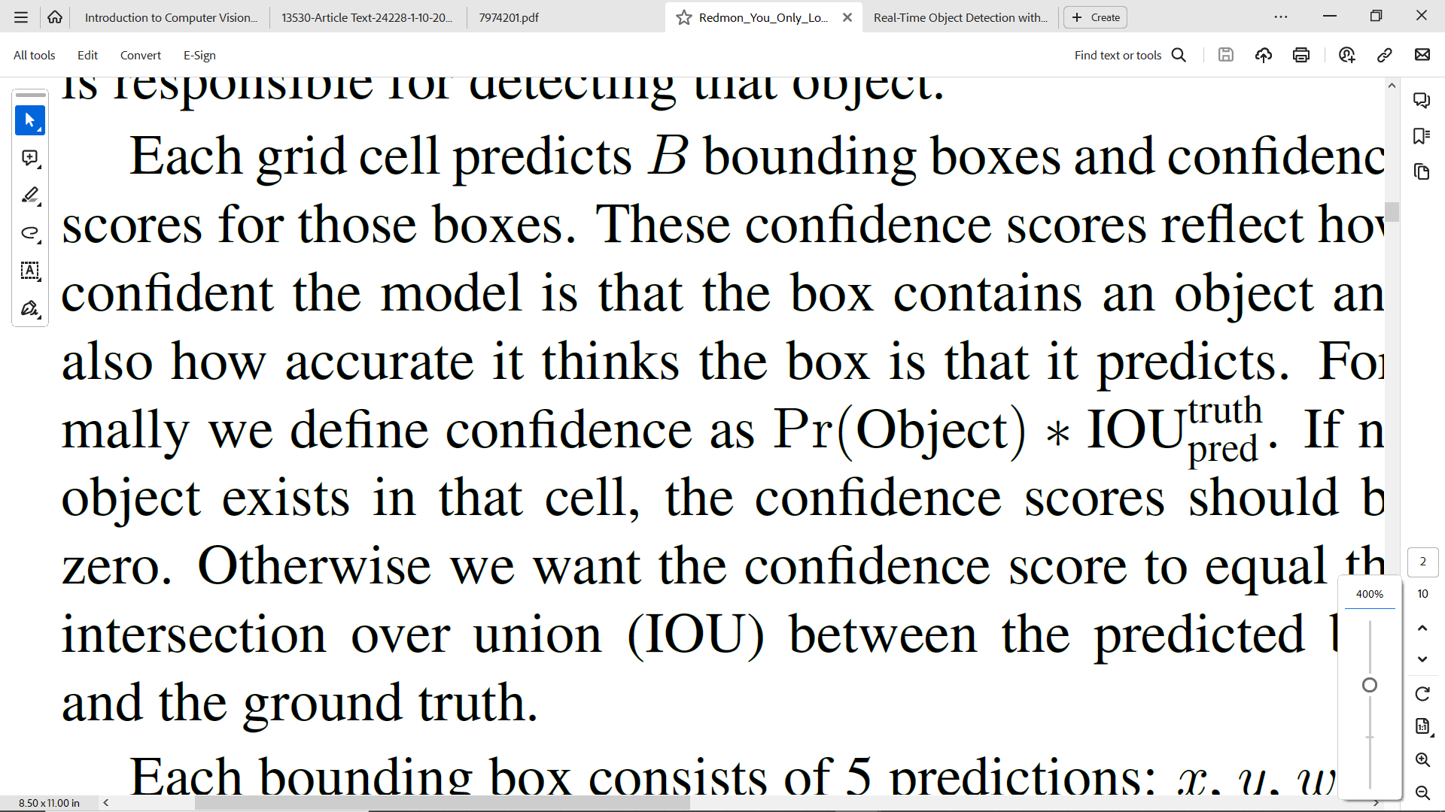
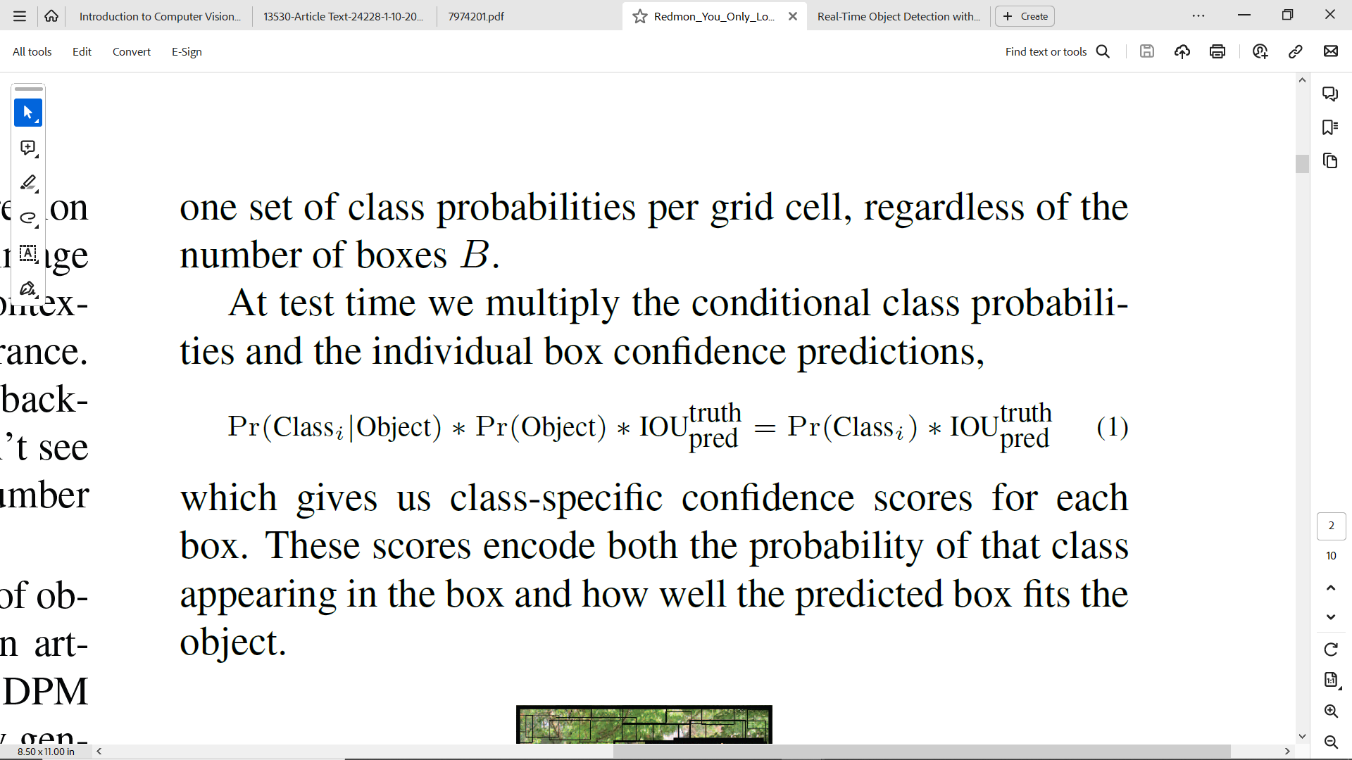

Slide 17
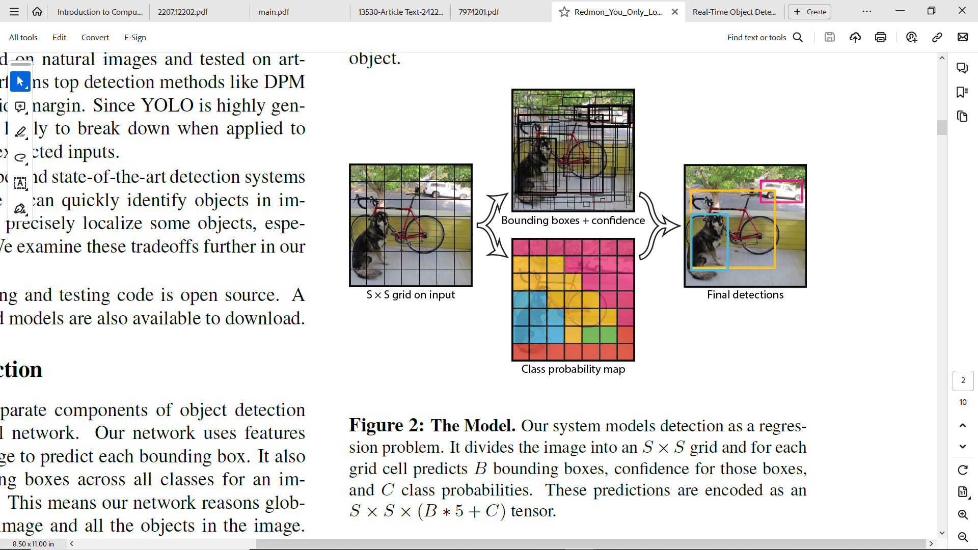

Slide 18
YOLO Architecture:
YOLO uses a deep CNN with 24 pre-trained layers, adapted for object detection by adding layers for predicting class probabilities and bounding box coordinates.
Grid-based Detection:
YOLO divides the image into an S × S grid, with each grid cell responsible for predicting multiple bounding boxes and confidence scores for object detection.
Bounding Box Predictors:
YOLO assigns one bounding box predictor per object during training, leading to specialization based on the highest Intersection over Union (IoU) with the ground truth.
Non-Maximum Suppression (NMS):
YOLO employs NMS as a post-processing step to eliminate redundant or incorrect bounding boxes, ensuring a single accurate bounding box per object.

Slide 19
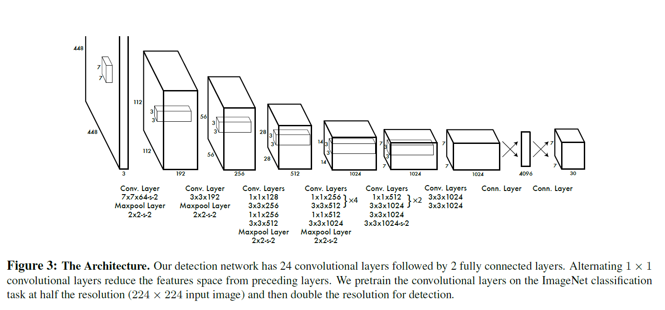

Slide 20
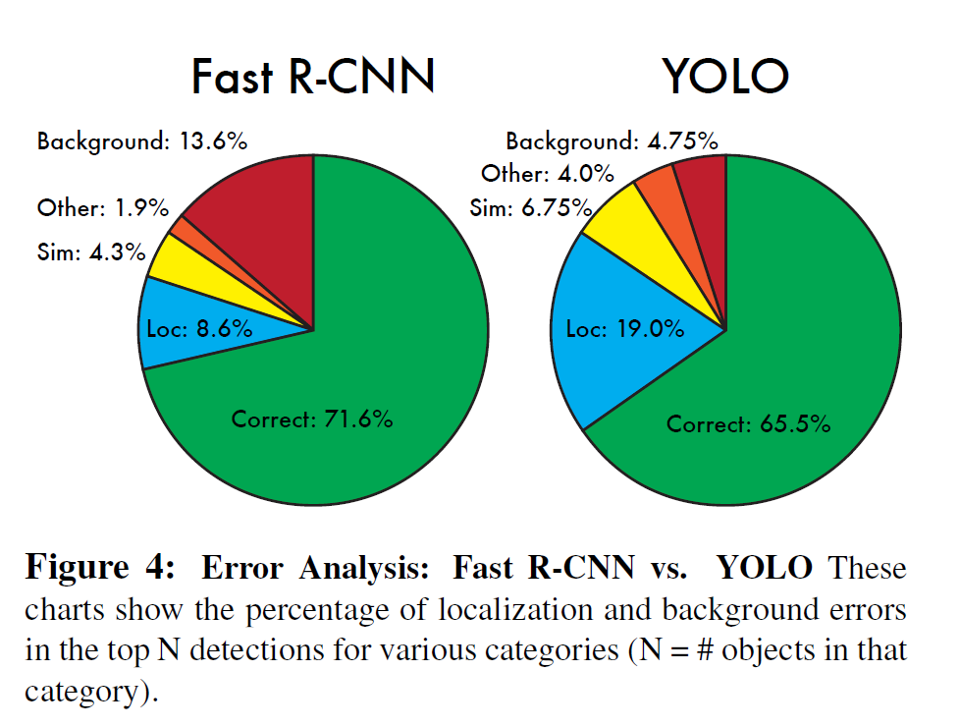

Slide 21
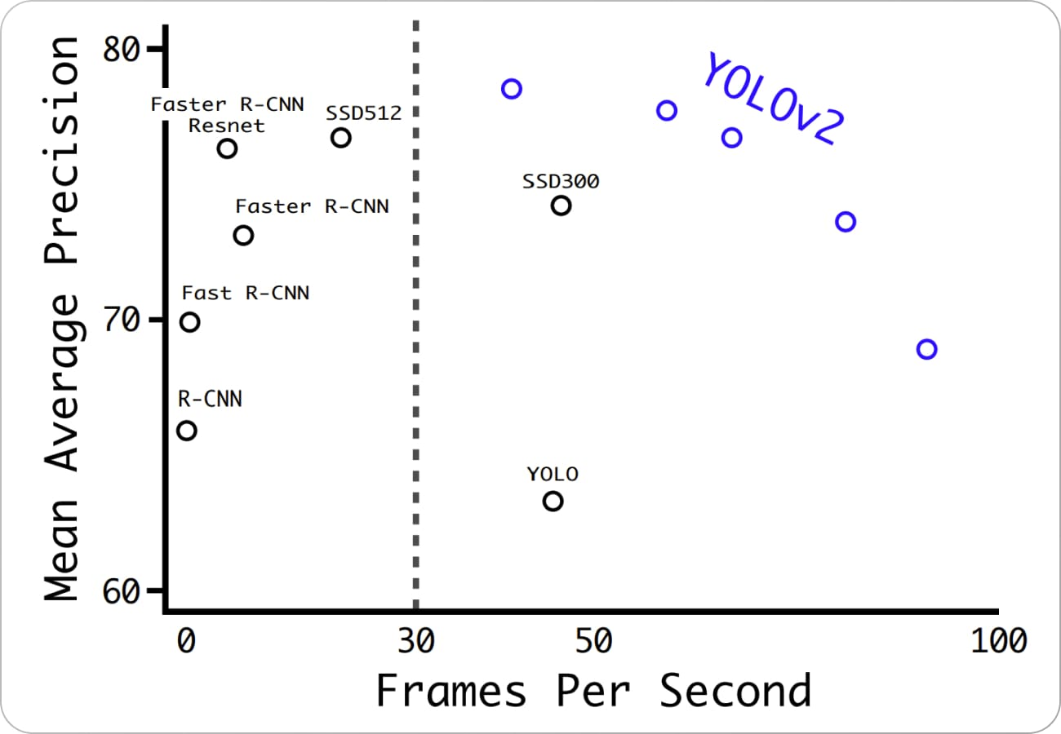

Slide 22
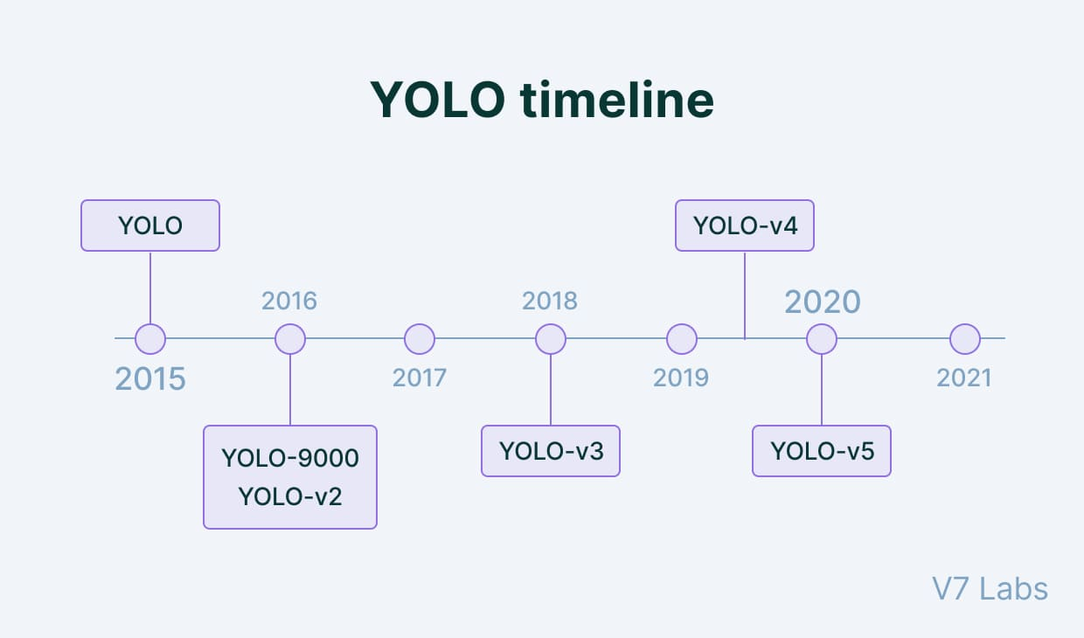

Slide 23
YOLOv10
Refined Model Architecture: Utilizes sequential convolution layers with grouped and pointwise convolutions for better feature extraction and parameter optimization.
Dual-Pathway Strategy: Incorporates both one2one and one2many pathways to enhance detection accuracy.
NMS-Free Training: Eliminates the need for non-maximum suppression (NMS) during training, reducing inference latency.
Enhanced Bias Initialization: Improves model convergence and stability.
Custom Post-Processing: Implements a specialized step for fine-tuning detection outputs.

Slide 24
3、DeepSORT

Slide 25
The SORT algorithm: foundation of Deep SORT
SORT, or Simple Online and Realtime Tracking, is the foundational algorithm for DeepSORT (Deep Learning for Multiple Object Tracking). SORT efficiently associates objects in consecutive frames using a detection-based approach and corrects associations with a Kalman filter. DeepSORT enhances data association with deep learning techniques, achieving state-of-the-art performance in multiple object tracking.

Slide 26
What is Deep SORT?
Deep SORT is an advanced multi-object tracking algorithm, extending SORT with a deep association metric based on appearance features. It handles occlusions, incorporates ID assignment, and shows significant improvements in tracking accuracy and robustness, making it valuable in computer vision and AI applications.

Slide 27
How does Deep SORT work?
Deep SORT comprises four key components:
Detection and Feature Extraction: Utilizes a CNN like YOLO for object detection, associating each detection with a high-dimensional appearance descriptor for matching.
Kalman Filter in State Prediction: Similar to SORT, Deep SORT employs a Kalman filter to predict the state (position, velocity, acceleration) of each object in the current frame, considering motion dynamics.

Slide 28
Data Association with Deep Appearance Metrics: Differs from SORT by combining motion information and appearance features, using the Hungarian algorithm for matching based on a cost matrix considering Mahalanobis distance for motion and cosine distance for appearance.
Track Management: Manages track lifecycles with heuristics like track confirmation (confirmed after detection in consecutive frames) and an age parameter to remove inactive tracks, reducing false positives.

Slide 29
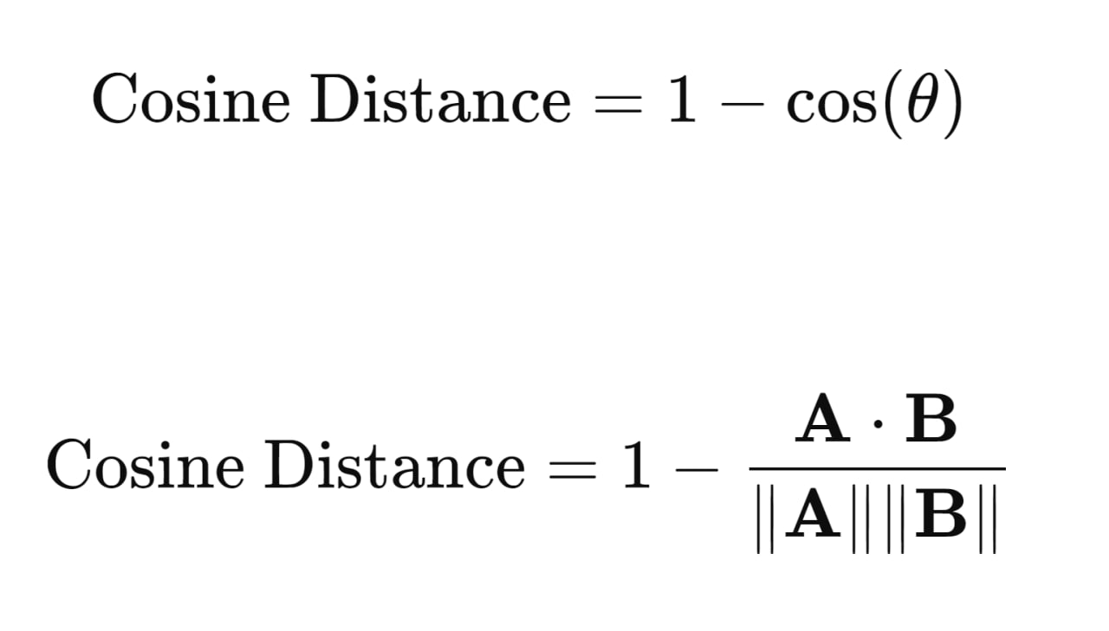
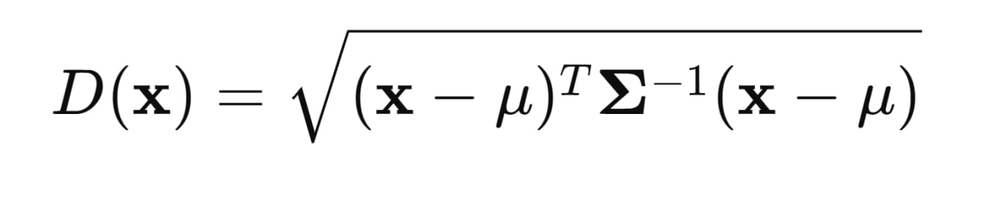
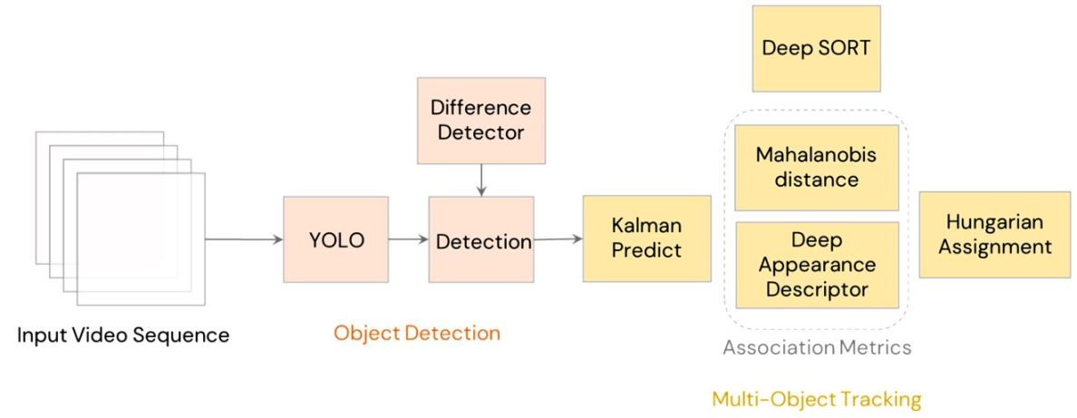
Architecture of Deep SORT

Slide 30
Advantages of Deep SORT include:
Robustness to Occlusions: Utilizes appearance descriptors for re-identifying objects even after occlusions.
Discrimination of Similar Objects: Appearance descriptors aid in distinguishing between objects that look similar.
Real-time Performance: Maintains near real-time operation despite added complexity, thanks to efficient feature extraction and association mechanisms.
Flexibility: Can be seamlessly combined with any state-of-the-art detector for enhanced adaptability.

Slide 31
Deep SORT Real-World Applications
Surveillance: Enhancing security by tracking individuals or objects in crowded scenes.
Sports analytics: Monitoring players to analyze game strategies and performance.
Autonomous vehicles: Assisting in pedestrian and vehicle tracking to improve safety and navigation.
Retail: Analyzing consumer behavior by tracking movements within a store.

Slide 32
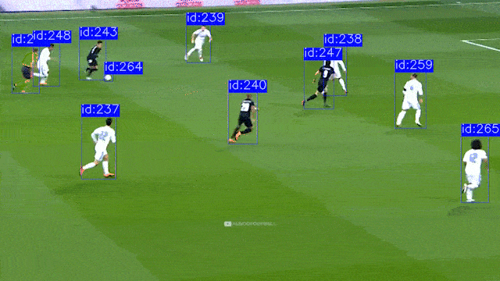

Slide 33
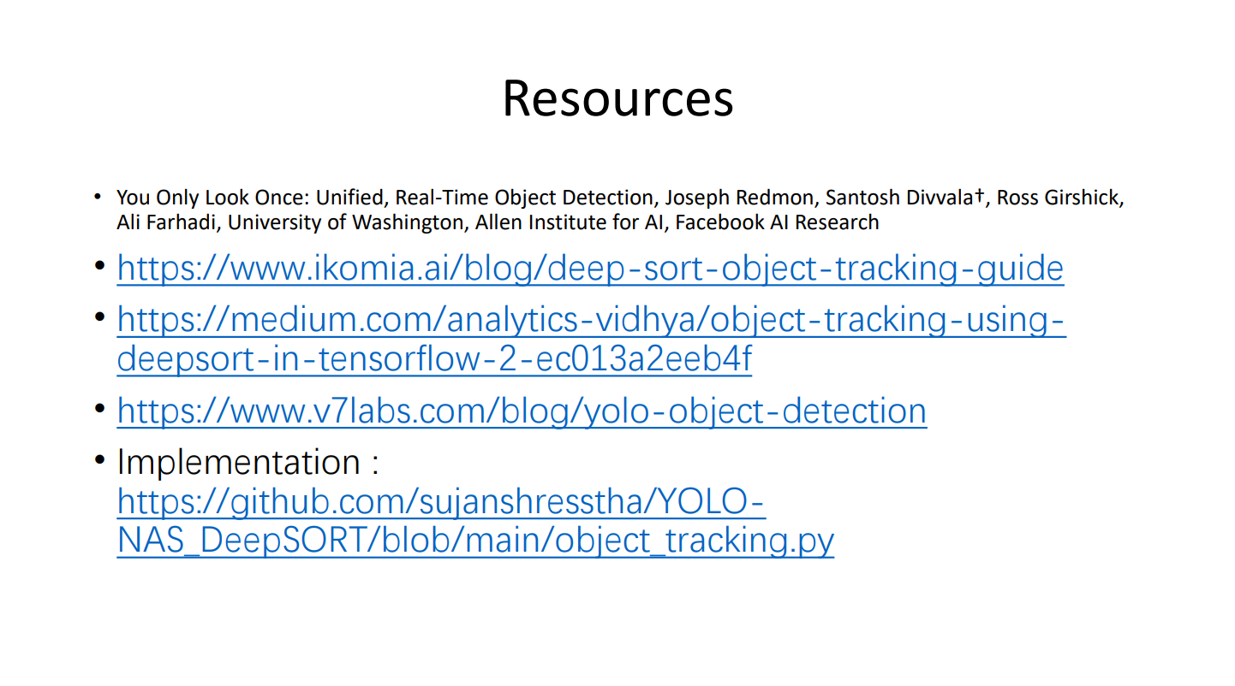

Slide 34
Thanks.

